Slide 1
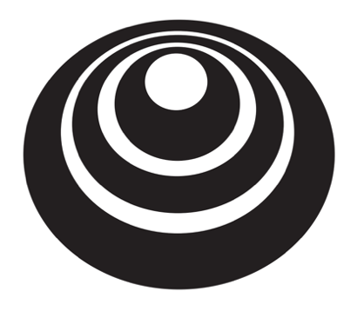
End-to-end deep learning
Whether to use
end-to-end learning
deeplearning.ai

Slide 2
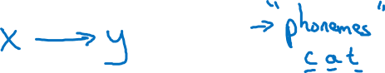
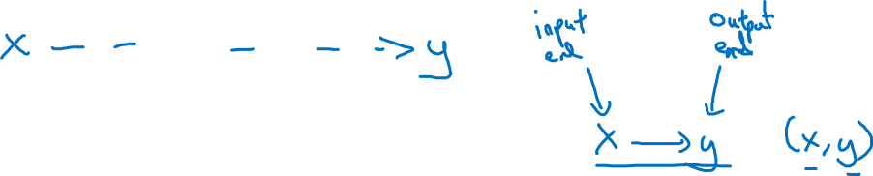
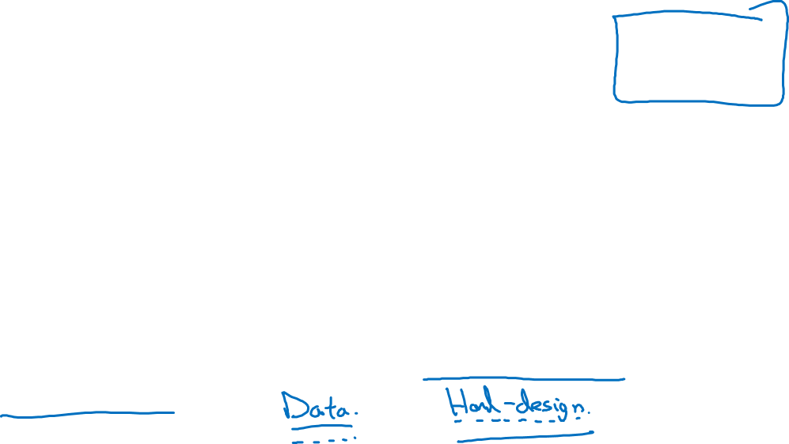
Pros and cons of end-to-end deep learning
Pros:
Let the data speak
Less hand-designing of components needed
Cons:
May need large amount of data
Excludes potentially useful hand-designed components
Notes:
t's not obvious that you want to force your learning algorithm to think in phonemes

Slide 3
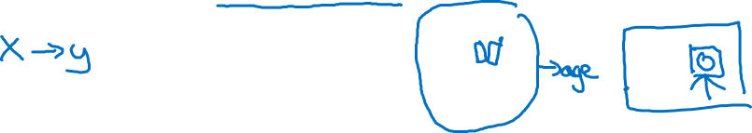
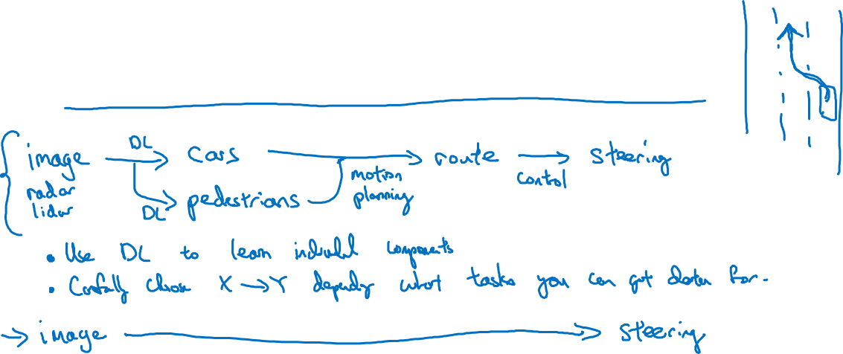
Applying end-to-end deep learning
Key question: Do you have sufficient data to learn
a function of the complexity needed to map x to y?
Notes:
this example illustrates is that
you want to use machine learning or use deep learning to learn
some individual components and when applying supervised learning you should
carefully choose what types of X to Y mappings you want to
learn depending on what task
you can get data for.
能否得到数据

